Slide 1
The Bulgarian Economy in Time of Global Instability
Economic Cooperation between Bulgaria and Korea - International Seminar
Sofia, February 24, 2015

Slide 2


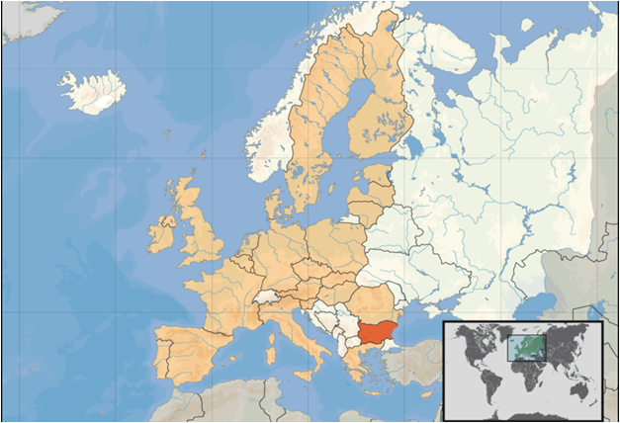
Republic of Bulgaria – Country Profile
Bulgaria is situated in the South-East of the Central Europe, in the Balkan Peninsula and shares a border with Turkey and Greece to the south, Macedonia and Serbia to the west, Romania to the north and the Black Sea to the east.
Area - 110,910 sq. km
The relief of Bulgaria is varied. In the relatively small territory of the country there are extensive lowlands, plains, hills, low and high mountains, many valleys and deep gorges.

Slide 3
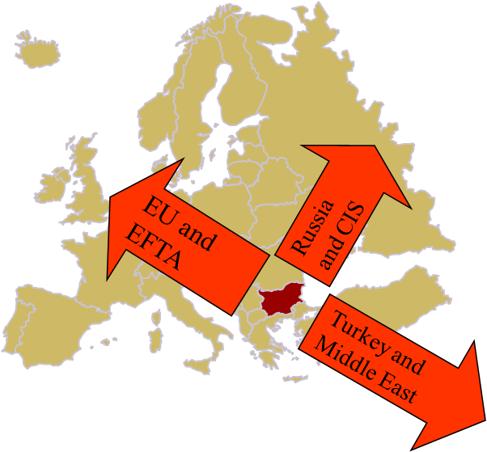
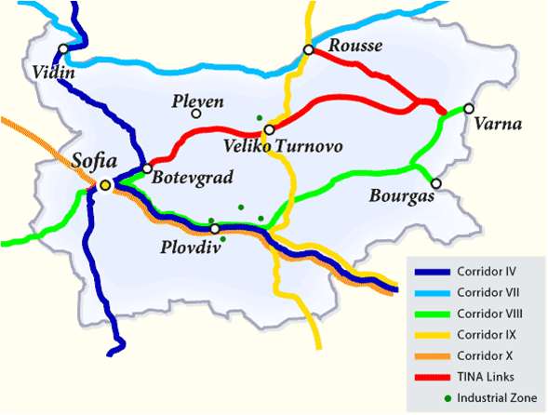
Strategic location
Transport infrastructure
The crossroad geographical situation of Bulgaria is defined by the five trans - European corridors between Europe, Asia and Africa. These are the most important capital of the country in the international relations. These are Corridor 4 from Scandinavian countries through Poland and Hungary towards Greece; Corridor 8 from Adriatic Sea to the Black Sea, Corridor 9 from Scandinavian countries through Saint Petersburg and Kiev to Greece and Turkey; corridor 10 from Western and Central Europe to India and the River Corridor 7 from Nordic Sea to the Black Sea via the Danube river.

Slide 4
Macroeconomic Indicators
Real GDP Growth (%)

Slide 5
Macroeconomic Indicators – cont.
Unemployment rate (%)

Slide 6
Macroeconomic Indicators – cont.
Inflation (%)

Slide 8
Fiscal Sector

Slide 9
Public debt (% GDP)

Slide 10
Fiscal stance – Bulgaria and EU
Average Government debt (2008-2013)
Average budget deficit (2008-2013)

Slide 11
Financial Sector
Currency board arrangement
  Established in mid 1997
  To be abolished after joining the euro area by (hopefully) 2020
The financial sector is dominated by the banking sector
Stock market and non-bank financial institutions remain underdeveloped
In general, the financial sector has not been hit hard and remains stable and relatively well capitalized and liquid

Slide 12
Banking sector
Assets to GDP ratio
Assets to GDP ratio

Slide 13
Banking sector – cont.
Capital adequacy and Liquidity
Performance
Notes:
Overall, the banking sector has weathered the crisis well due to strong banking supervision, conservative provisioning and a build-up of capital buffers. At the aggregate level, the banking system's capitalization was little changed relative to the pre-crisis years. The regulatory capital adequacy ratio stayed well above the mandatory level of 12%. The average quality of banks' loan portfolio however experienced serious changes. On the positive side, NPLs remain well-provisioned for with the coverage ratio of all buffers in the banking system reaching 99.8% of gross NPLs.
Despite a cyclical compression of profitability, the banking system remains stable, well capitalized and highly liquid, and the same applies to individual banks. NPLs are reported in a conservative manner and covered with an additionally created capital buffer. The central bank already declared it will remain committed to further develop the domestic insolvency framework in line with the best international practices. In this regard, the design and implementation of an effective strategy for addressing the existing NPL stock in Bulgaria remain seriously constrained by prevailing uncertainty and the current low stage of asset market development. The monetary authorities have signaled they will rely on conservative banking supervision. The BNB will continue to play a supportive role to encourage a steady but gradual process of reducing distressed assets and releasing the associated collateral that avoids unduly disturbing markets.

Slide 14
Policy Challenges Ahead
Ensuring a smooth corporate deleveraging process.
Sustaining the adjustment of the external position, while continuing to attract productive foreign capital.
Distressed labour market; persistent unemployment; job losses concentrated in the low-skilled segment and skill mismatches.
Preserving financial stability and joining the euro area.

